Slide 1



Classifying Shooting Incident Fatality in NYC
Predictive Policing with Machine Learning
Presented By: Utkarsh Raj

Slide 2

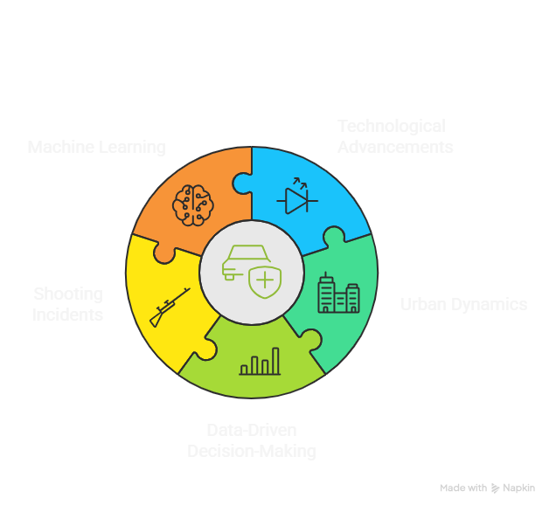
Enhancing Public Safety Through Innovation
  The changing landscape of public safety is affected by technology and new forms of municipalities.There is a growing expectation for police departments to provide data-supported results in their decision-making.
  Every loss of life in a shooting event, creates damage to public safety, community trust, and the responsible allocation of police resources.
  Machine Learning is a predictive methodology that also detects, monitors, and potentially mitigates risk related to shooting events.

Slide 3

Business Impact
  Proactive Public Safety: Allows earlier exposure to high-risk incidents allowing for timely intervention and improved overall community safety.
  Effective Resource & Risk Use: Provides police resources with efficiency and reduces risk for operational decisions while utilizing data driven decision-making processes.
  Increased Community Trust: Develops long-term public confidence by exemplifying commitment to safety, transparency, and directed action.

Slide 4
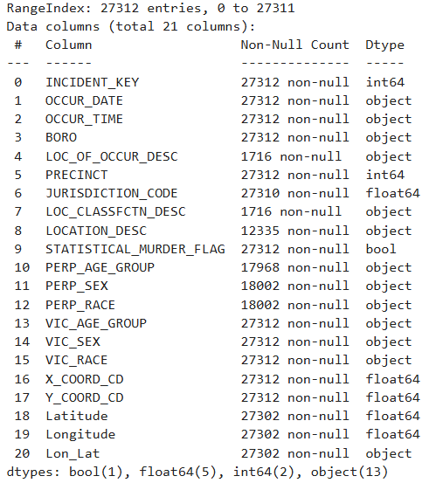
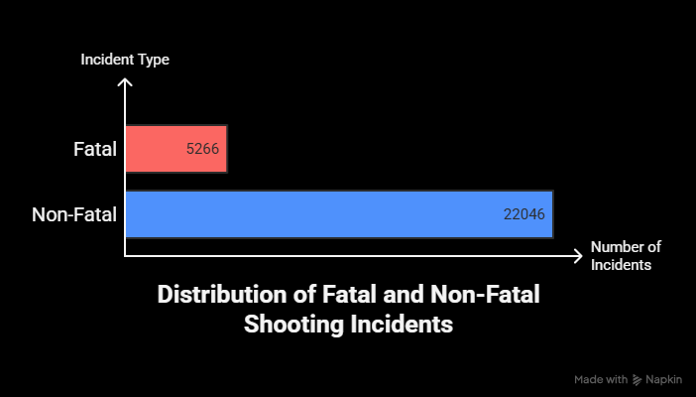

Dataset Overview
  Source: NYPD Shooting Incident Data
  Total Records: 27,312
  Features: 20+
  Key Data Points:
    Borough, Precinct, Time, Victim/Perpetrator Demographics, Location Details, Fatality Flag
  Contains Missing Values

Slide 5

EDA Highlights and Insights
Phase 1
Phase 2
Phase 3
Incident Distribution & Imbalance
Temporal & Demographic Insights
  Correlation Heatmap
  Geo Clustering (Region_ID)

Slide 6
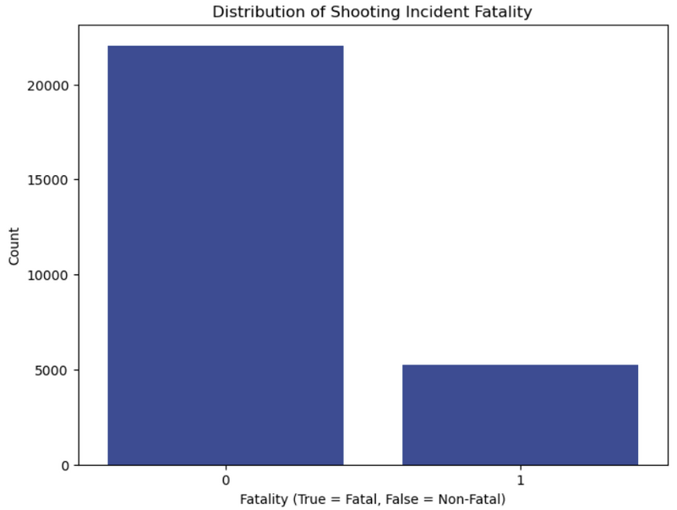
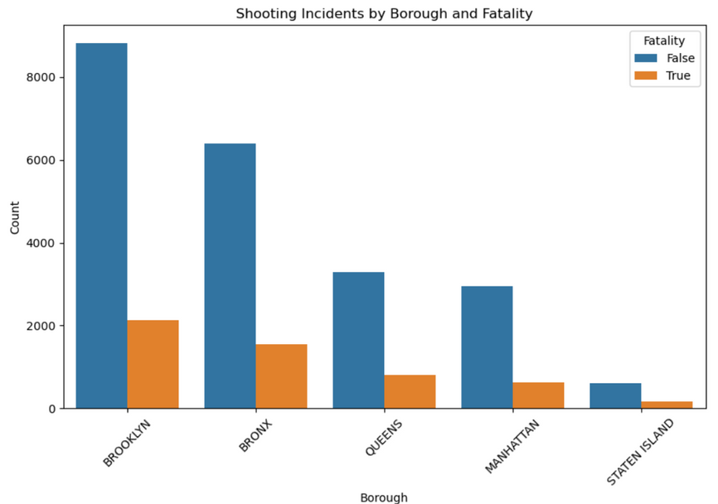
Incident Distribution & Imbalance
  Brooklyn and Bronx report the highest number of both total and fatal incidents.
  Suggests targeted intervention and policing strategies in these regions.
The dataset is heavily imbalanced: ~81% non-fatal vs ~19% fatal incidents.

Slide 7
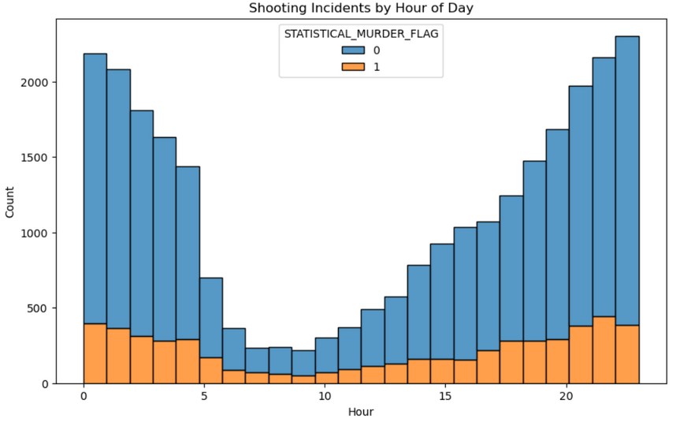
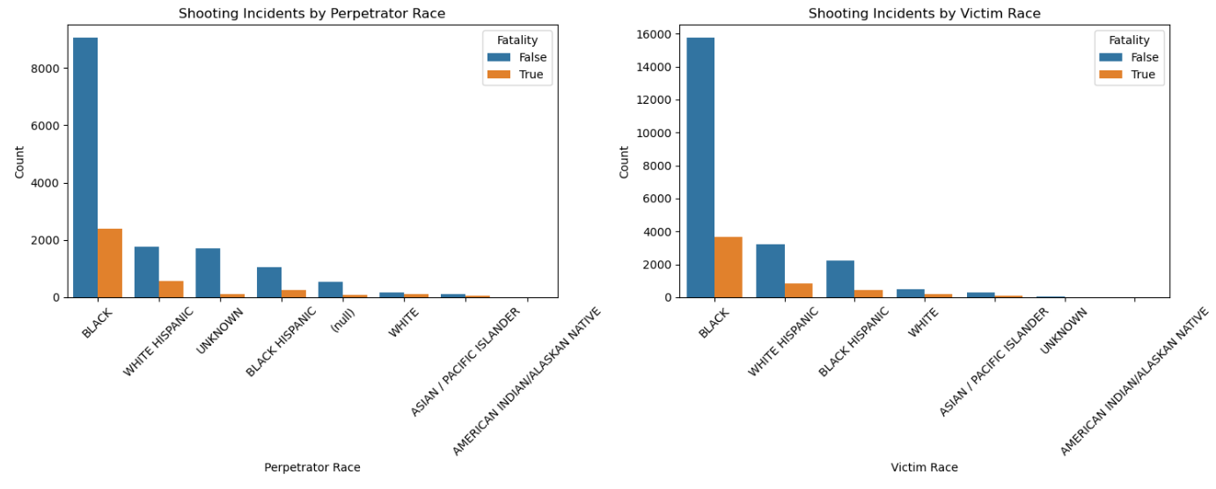
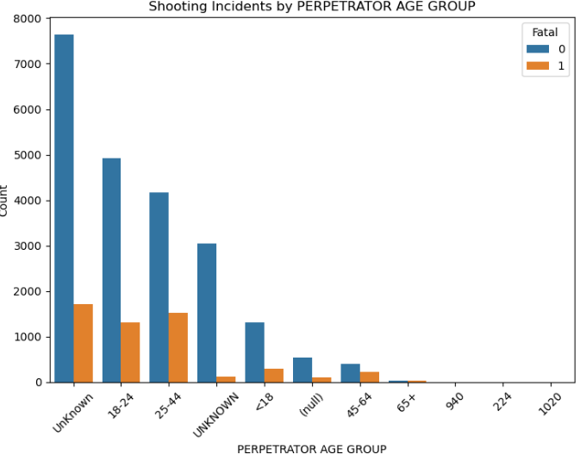
Temporal & Demographic Insights
  Fatal shootings spike between 10 PM and 3 AM, aligning with high-risk time windows.
  Implies the need for increased patrol presence during late-night hours.
  Certain racial groups appear more frequently in both perpetrator and victim roles.
  Chi-square tests confirm a statistically significant relationship with fatality outcomes.

Slide 8
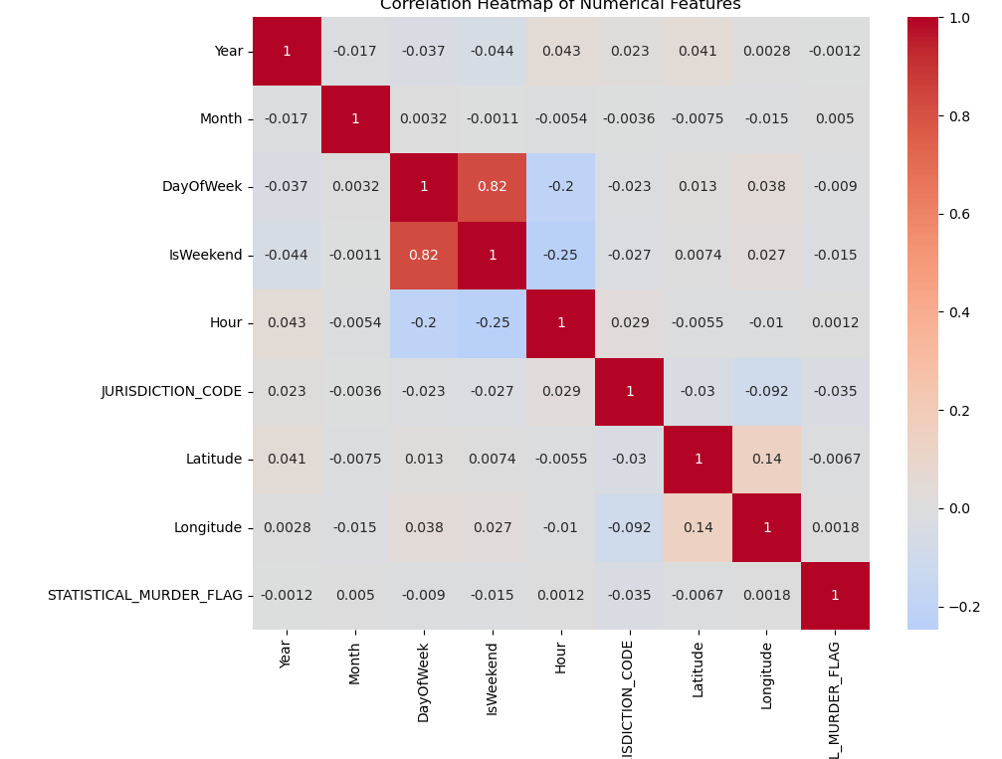
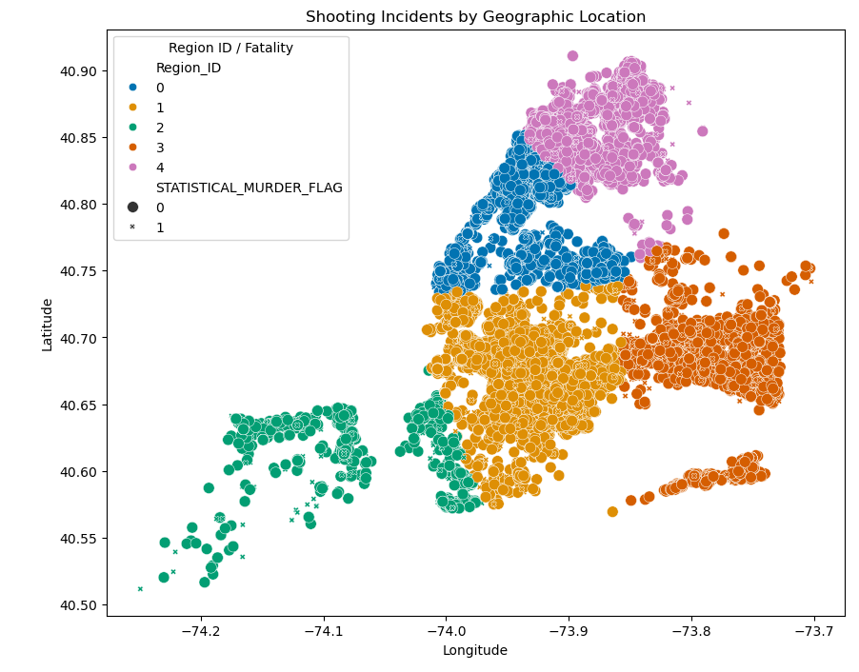
Correlation Heatmap & Geo Clustering
  Weak linear correlations with the target variable (STATISTICAL_MURDER_FLAG).
  However, time (hour), region, and categorical variables still play critical roles in model performance.
  High-fatality hotspots are identifiable in specific clusters.
  These geographic zones can guide location-based predictive policing and patrolling strategies.

Slide 9
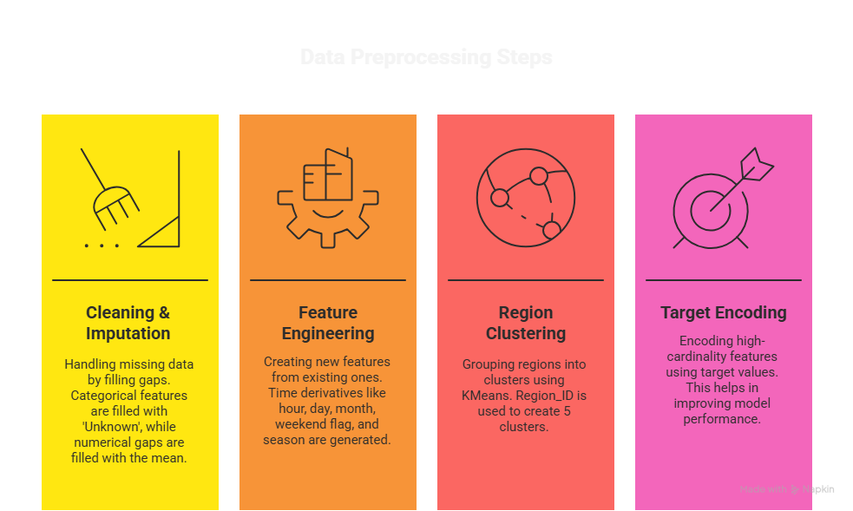
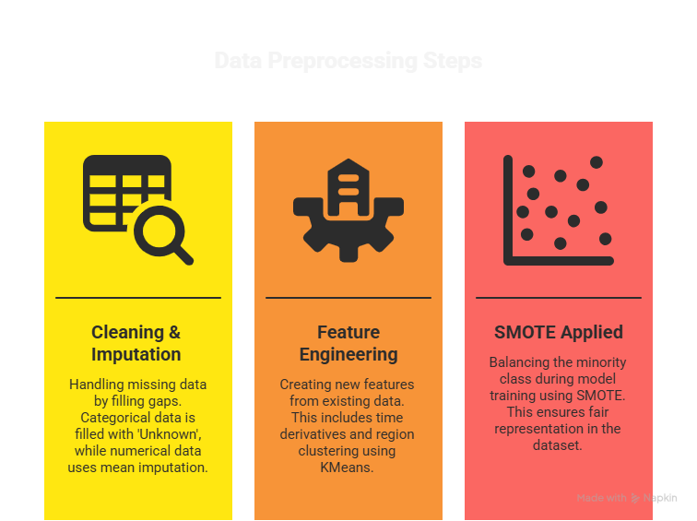
Data Preprocessing Strategy

Slide 10



Model Building Pipeline
Train-Test Split
Scaling & Encoding Pipeline
Class Balancing with SMOTE
Hyperparameter Tuning (GridSearchCV)
Data was split into 80% training and 20% testing sets, ensuring that the fatal and non-fatal classes are proportionally represented in both sets.
Numerical features were standardized using StandardScaler, and categorical variables were encoded using one-hot encoding for compatibility with ML algorithms.
Synthetic Minority Over-sampling Technique (SMOTE) was used to balance the dataset by generating synthetic examples of the minority (fatal) class.
A grid search was performed over a range of hyperparameters to find the optimal settings for each model based on F1-score performance.

Slide 11
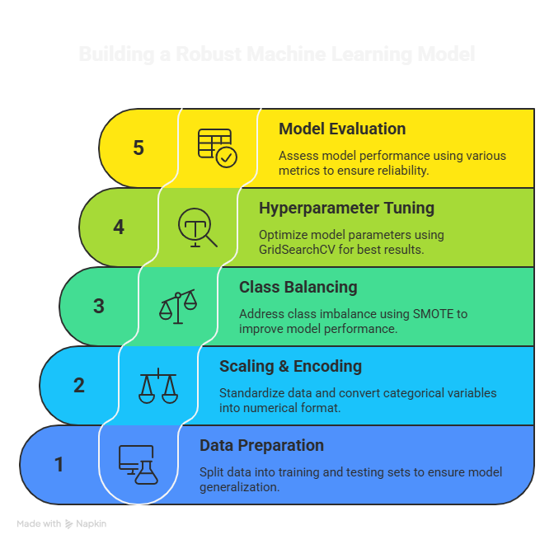
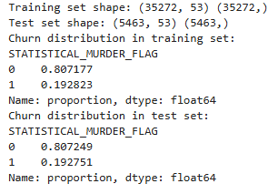
Machine Learning Modeling Framework

Slide 12
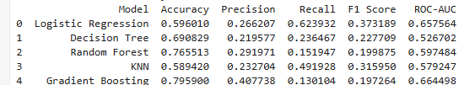

Baseline Model Results (Before Tuning)
Baseline Model Results (After Tuning)

Slide 13
Model Comparison Table
Model | Accuracy | Precision | Recall | F1 Score | ROC-AUC | Verdict
Logistic Regression | 59.6% | 0.26 | 62.4% | 0.37 | 0.65 | High recall, low F1.
Decision Tree (Tuned) | 74.5% | 0.33 | 32.3% | 0.32 | 0.65 | Balanced but recall moderate.
Random Forest (Tuned) | 76.6% | 0.30 | 15.8% | 0.20 | 0.63 | High accuracy, but terrible recall.

Slide 14
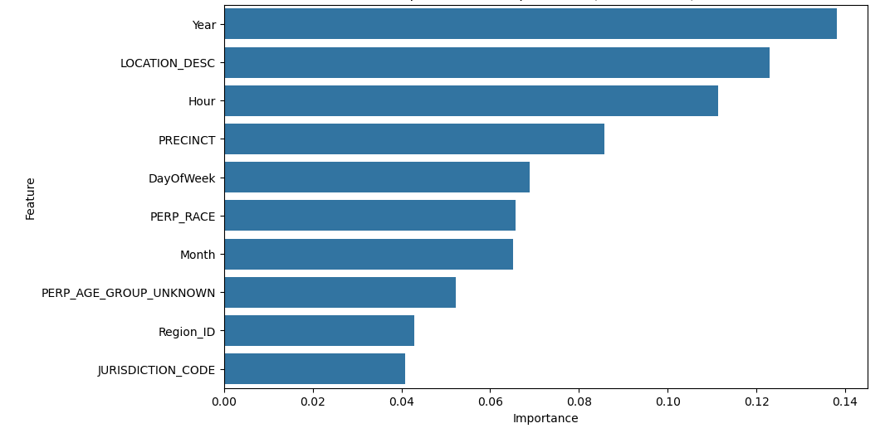
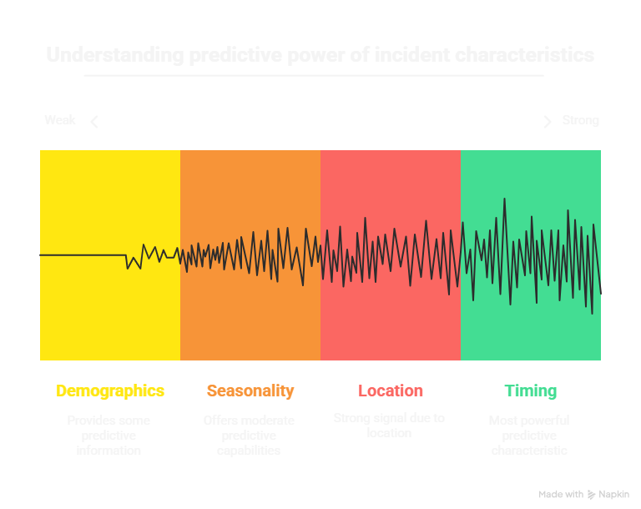
Feature Importance
Hour of Incident: Time of the day significantly impacts fatality rates — incidents occurring during late-night or early-morning hours are more likely to be fatal.
Region_ID (Location): Geo-clustered regions show that certain hotspots (urban pockets) consistently record higher fatality rates, likely due to socio-economic or gang-related factors.
Victim/Perpetrator Demographics: Attributes such as race, age group, and gender of both parties show strong association with fatal outcomes, as validated by chi-square tests.
Seasonality: Fatal incidents vary by season — higher activity in summer and early fall, indicating environmental or behavioral triggers.

Slide 15

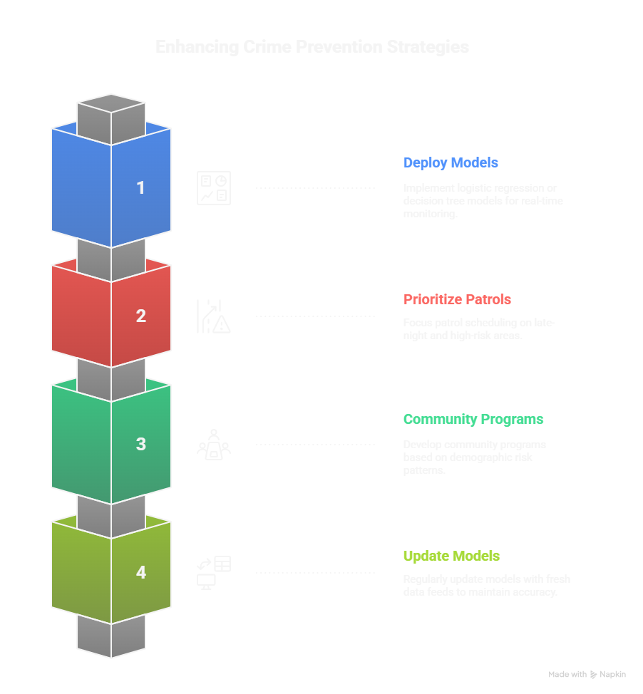
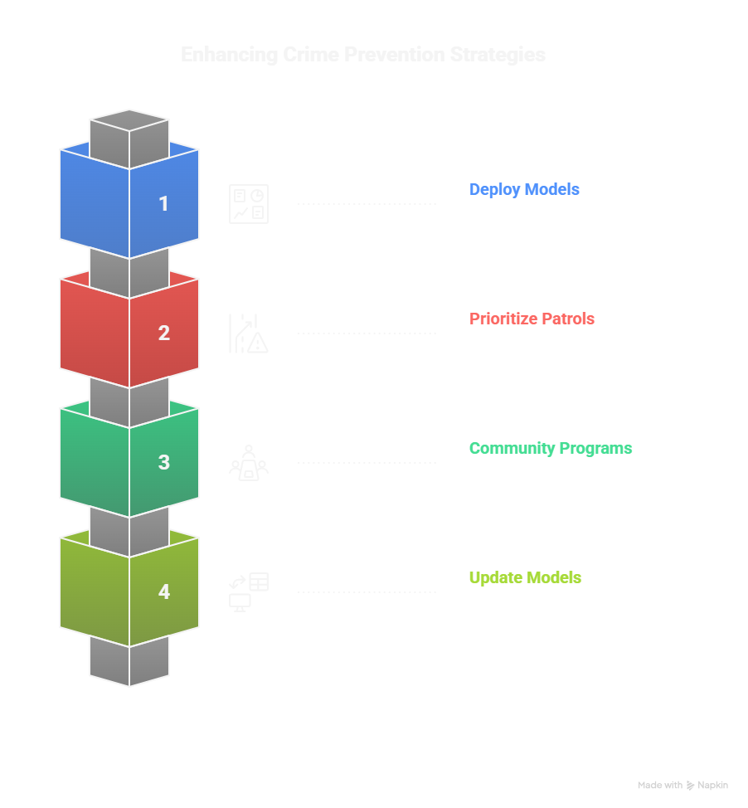
Business Recommendations
& Conclusion
Use the Logistic Regression model for high recall and quick risk flagging, or Decision Tree for interpretable, balanced decision-making during live incident analysis.
Focus law enforcement presence during late-night hours and in geo-clustered high-risk areas identified by the model to proactively reduce fatality rates.
Leverage insights on victim and perpetrator demographics to develop targeted outreach, education, and intervention programs in vulnerable communities.
Maintain model accuracy and relevance by retraining with updated incident data every quarter, reflecting evolving crime patterns and ensuring adaptability.

Slide 16

Thank you!
UTKARSH RAJ
E-MAIL: uraj757@gmail.com

